Slide 1
Ruby Presentation
Florida State University
By: Drew Smith
Notes:
----- Meeting Notes (4/11/16 12:44) ---

Slide 2
History of Ruby
Released in the mid-1990’s
Originated in Japan
Yukihiro “Matz” Matsumoto
Witten in C
Based on Perl, Smalltalk, Eiffel, Python, and Lisp
More powerful, more OO
Highly portable (Unix, Linux, Windows)
Aim was in “making Ruby natural, not simple”

Slide 3
Ruby Theory
“Often people, especially computer engineers, focus on the machines. They think, by doing this, the machine, will run faster. By doing this, the machine will run more effectively, etc. They are focusing on machines. But in fact we need to focus on humans, on how humans care about doing programming or operating the application of the machines. We are the masters. They are the slaves.” - Matz
Notes:
Explains that humans should not have to think like computers. Matz ideally wants to create a programming language that humans could easily relate to.

Slide 4
Ruby Features
Dynamic Programming Language
Object-Oriented
Scripted Language
Uses Single-Inheritance
Cross Platform

Slide 5
Dynamic Programming
Referred to as 'weakly typed' which means that variables are not bound to a particular type until runtime.
Features "dynamic typing," which gives the programmer more flexibility to pass parameters at runtime without having to define them beforehand.
This dynamic typing is accomplished by using an interpreted language, rather than a compiled language.
Notes:
----- Meeting Notes (4/11/16 12:44) -----
Dynamic Programming in Ruby means tht variables are not bound to a particular type until runtime. This gives the programmer greater flexibilty by using an interpreted language rather than having it go through the compile and linking phases.

Slide 6
Object-Oriented
Ruby is a perfect Object Oriented Programming Language. EVERYTHING in Ruby is an object!
Familiar features:
• Data Encapsulation
• Data Abstraction • Polymorphism • Inheritance

Slide 7
Scripted Language
Interpreted (no linking or compilation)
Less efficient to run
Faster to develop
High level – a single statement is more powerful
No type declarations, typeless
Powerful built-in types
Rarely used for complex algorithms or data structures.
Notes:
----- Meeting Notes (4/11/16 12:44) -----
Since Ruby is a scripting language, there is no compilation or linking phase. This allows Ruby code to be faster developed, but yet a less efficent execution

Slide 8
Meta programming
Meta programming is the writing of computer programs that write or manipulate other programs ( or themselves) as their data or that do part of the work during compile time that is otherwise done at run time.
In many cases, this allows programmers to get more done in the same amount of time as they would take to write all the code manually.
Notes:
----- Meeting Notes (4/11/16 12:47) -----
Meta programming is one of Ruby's strong points. It allows the writting of programs that can create, write, and manipulate its own code or even other programs.

Slide 9
Variables in Ruby
• Local Variables: Local variables are the variables that are defined in a method. Local variables are not available outside the method. Local variables begin with a lowercase letter or underscore.
• Instance Variables: Instance variables are available across methods for any particular instance or object. That means that instance variables change from object to object. Instance variables are preceded by the at sign (@) followed by the variable name.
• Class Variables: Class variables are available across different objects. A class variable belongs to the class and is a characteristic of a class. They are preceded by the sign @@ and are followed by the variable name.
• Global Variables: Class variables are not available across classes. If you want to have a single variable, which is available across classes, to define a global variable. They are always preceded by the dollar sign($).

Slide 10
Creating Objects
You can create objects in Ruby by using the method new of the class.
The method new is a unique type of method, which is predefined in the Ruby library. The new method belongs to the class methods.
Here is the example to create an object, cust1, in a class Customer:
Ex. cust1 = Customer.new

Slide 11
Arrays
Literals of Ruby Array are created by placing a comma-separated series of object references between the square brackets. Arrays in Ruby can consist of different types!
Example:
ary = [ "fred", 10, 3.14, "This is a string", "last element", ]
ary.each do |i|
puts i
end
Result:
fred
10
3.14
This is a string

Slide 12
Hashes
A literal Ruby Hash is created by placing a list of key/value pairs between braces, with either a comma or the sequence => between the key and the value. A trailing comma is ignored.
Example:
hsh = colors = { "red" => 0xf00, "green" => 0x0f0, "blue" => 0x00f }
hsh.each do |key, value|
print key, " is ", value, "\n"
end
Results:
green is 240
red is 3840
blue is 15

Slide 13
Ranges
A Range represents an interval.a set of values with a start and an end. Ranges may be constructed using the s..e and s...e literals, or with Range.new.
Ranges constructed using .. run from the start to the end inclusively. Those created using ... exclude the end value. When used as an iterator, ranges return each value in the sequence.
A range (1..5) means it includes 1, 2, 3, 4, 5 values and a range (1...5) means it includes 1, 2, 3, 4 values.
Ex.
(10..15).each do |n| Produces:
print n, ' ' 10 11 12 13 14 15
end

Slide 14
Ruby irb
Irb is a Ruby interpreter/interactive Ruby shell
Allows you to type commands into the command line and see immediate results

Slide 15
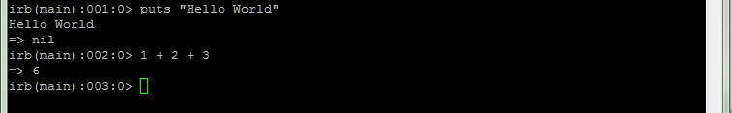
irb (Ruby interpreter)
Allows you to type commands one at a time and see results

Slide 16
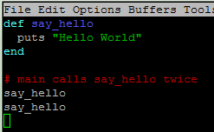
Main method?
Ruby does not have a main method
Just write your code directly in a file
Ruby statements do not end with semicolons
Method calls don’t need parenthesis

Slide 17
Unlimited Precision
C++/Java
There is a maximum value for integers
There is a maximum value for longs
Ruby
There is no maximum!
Fixnum
Bignum

Slide 18

Variables/Types
Do not declare types in Ruby!
Type of variable can change throughout program

Slide 19

String Multiplication
Strings can be multiplied by integers
Concatenates string repeatedly

Slide 20
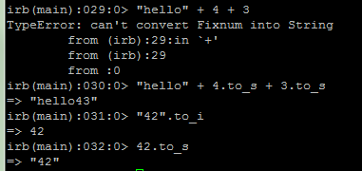
Strings and Ints
Integers and Strings cannot be concatenated in Ruby
to_s – converts to string
to_i – converts to integer

Slide 21


Loops
The for loop
Java
Ruby

Slide 22



Loops
The while loop
Java
Ruby

Slide 23

Constants
Ruby doesn’t really have constants
Instead declare a variable at the top of your code and it will be accessible everywhere
You will get a warning if you change a constant, but you can change it anyway (bad style)

Slide 24
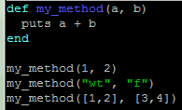
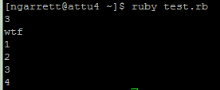
Parameters
Parameters are declared by writing their names (no types)
May seem odd that we can pass ints, strings, or arrays

Slide 25
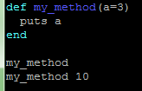

Default Parameter Values
You can give a default value to parameters
The caller doesn’t have to pass a value

Slide 26
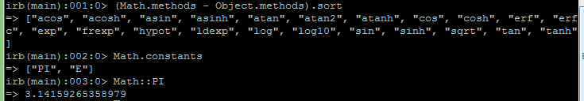
Math
The Math module has methods and constants that you can use
Has many of the same methods as Java

Slide 27


Reading from the Console
Java
Ruby

Slide 28

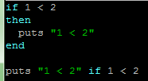
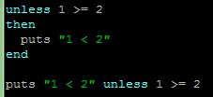
If Statements
Java
Ruby

Slide 29
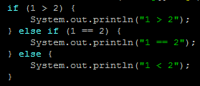
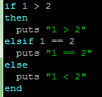
elsif
Java
Ruby

Slide 30

Logical Operators
== != >= <= < > (just like C++, Java)
<=>
Duck Typing allows these operators to work on variables/objects as well

Slide 31

Arrays
Arrays
More flexible than Java, can mix types
Many useful methods
map, sort, delete, each, min, max, include?, select, shuffle, slice
Negative Indexing

Slide 32
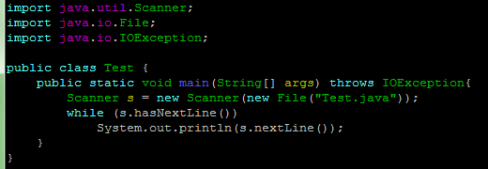

Reading Files
Java
Ruby

Slide 33
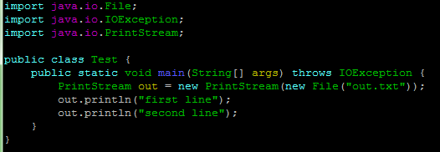
Writing Files
Java
Ruby

Slide 34
Why Ruby?
Tooling
Libraries
Code Quality
Test Automation
Large Community
Popular in The Valley
Responsible Developers
Productivity
Next Generation
Notes:
Tooling - Rails provides fantastic tooling that helps you to deliver more features in less time. It provides a standard structure for web apps, where all the common patterns are taken care of for you.
Libraries - There's a gem for just about anything you can think of. They are all publicly available and searchable through https://rubygems.org/.
Code Quality - Generally, we find the quality of third party Ruby code to be significantly higher than its PHP equivalent.
Test Automation - The Ruby community is big in to testing and test automation. We believe this is incredibly valuable in helping to deliver good quality software and is one of the reason the Ruby libraries are so great.
Large Community - Pretty much every major city in the world has a Ruby community that runs regular meetups. It's one of the most popular languages on social coding site Github.
Popular in The Valley - History has shown that technology that's been popular within Silicon Valley has gradually been adopted across the world. If you look at the big startup successes of recent years, such as Airbnb, Etsy, GitHub & Shopify - they are are all on Ruby on Rails.
Responsible Developers - You tend to find Ruby developers are more closely aligned around the the rules of responsible development.
Productivity - Ruby is an eloquent and succinct language, which when combined with 3rd party libraries, enables you to development features incredibly fast and some would say it's the most productive programming language around.
Next Generation - Ruby on Rails seems to be the language of choice for a number of the popular online code schools

Slide 35
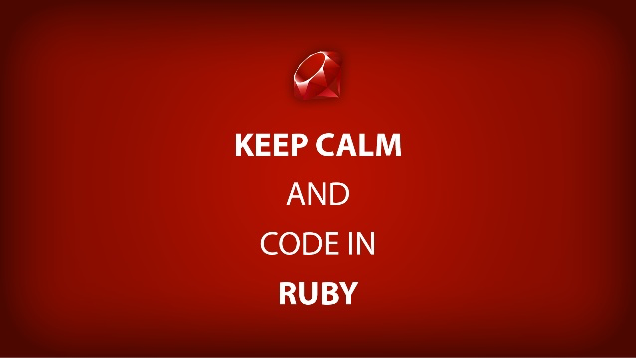
Ruby on Rails
Huge counterpart to Ruby’s success
Created by Heinemeir Hansson in 2003
A software framework that extends Ruby
Open source software
Free…
Free?
FREEEEE!

Slide 36
Ruby on Rails cont.
Ruby on Rails is most popular for its website development
Rails is a Model-view-controller (MVC) framework, providing default structures for a database, a web service, and web pages.
Encourages the use of XML for data transfer, and HTML, CSS and JavaScript for user interfacing.
Other software engineering patterns:
Convention over configuration (CoC)
Don’t repeat yourself (DRY)

Slide 37
Ruby on Rails Examples
Twitter
Yellow Pages
IBM
Amazon
Oracle
NASA
Yahoo
GitHub
Twitch
SoundCloud
Hulu
Square
Basecamp
Highrise

Slide 38

Back at it again with Ruby…
So…who is ready to
program in Ruby!?
Questions?

